Slide 1
Business Intelligence G. Mudare
Notes:
Introduce yourself to the students and also find out there names
Have them give you in 30 seconds a summary of who they are and what there interest in IT is

Slide 2
Introduction to modelling data

Slide 3
Modeling data
You can use multiple tables from multiple sources, and define the relationship between them.
You can also create your own custom calculations and assign new metrics to view specific segments of your data

Slide 4
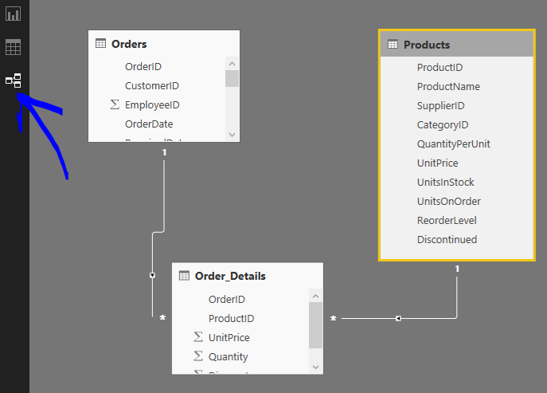
Managing data relationships
Power BI allows you to visually set the relationship between tables or elements
Use the Relationship view, found on the far left side of the screen next to the Report canvas.

Slide 5
Managing data relationships
From the Relationships view, you can see a block that represents each table and its columns, and lines between them to represent relationships.
To remove a relationship, right-click on it and select Delete.
To create a relationship, drag and drop the fields that you want to link between tables.( same as in Access)
To hide a table or individual column from your report, right-click on it in the Relationship view and select Hide in Report View
select Manage Relationships in the Home tab for a more detailed view of your data relationships

Slide 6
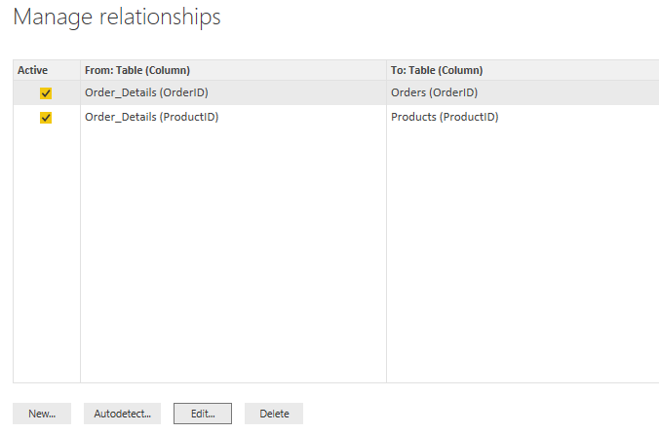
Managing data relationships

Slide 7
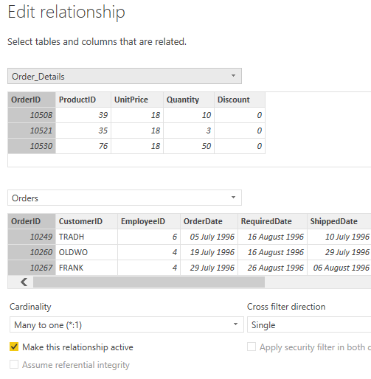
Managing data relationships
Select Edit in the Manage Relationships dialog to manually edit your relationships. This is also where you can find advanced options to set the Cardinality and Cross-filter direction of your relationships.

Slide 8
Create calculated columns
A calculated column is a new column that you create by defining a calculation that transforms or combines two or more elements of existing data
Calculated columns are a useful tool for quickly creating models and visualizations.
To create a calculated column, select the Data view in Power BI Desktop from the left side of the report canvas
From the Modeling tab, select New Column. This will enable the formula bar where you can enter calculations using DAX (Data Analysis Expressions) language.

Slide 9
Optimizing data models
Power BI Desktop has tools to optimize your data, and make it more usable for you to create reports and visuals, and for viewing your shared reports
To hide a column in the Fields pane of Power BI Desktop, right-click on it and select Hide.
Hidden columns are not deleted; if you've used that field in existing visualizations, the data is still in that visual, and you can still use that data in other visualizations too, the hidden field just isn't displayed in the Fields pan
If you view tables in the Relationships view, hidden fields are indicated by being grayed out.

Slide 10
Sorting visualization data by another field
The Sort by Column tool, available in the Modeling tab, is very useful to ensure that your data is displayed in the order you intended.
As a common example, data that includes the name of the month is sorted alphabetically by default, so for example, "August" appears before "February“
To change a data type from the report canvas, select the column in the Fields pane, and then use the Format drop-down menu to select one of the formatting options

Slide 11
Create calculated measures
A measure is a calculation that exists in your Power BI data model. To create a measure, in Report view select New Measure from the Modeling tab.
In Power BI, a defined calculation is called a measure. To create a measure, select New Measure from the Home tab. This opens the Formula bar where you can enter the DAX expression that defines your measure.
Once you've created a new measure, it will appear in one of the tables on the Fields pane, found on the right side of the screen.
Power BI inserts the new measure into whichever table you have currently selected, and while it doesn't matter exactly where the measure is in your data, you can easily move it by selecting the measure and using the Home Table drop-down menu.

Slide 12
Create calculated tables
Calculated tables are a function within DAX that allows you to express a whole range of new modeling capabilities.
For example, if you want to do different types of merge joins or create new tables on the fly based on the results of a functional formula, calculated tables are the way to accomplish that.
To create a calculated table, go to Data view in Power BI Desktop, which you can activate from the left side of the report canvas.
Select New Table from the Modeling tab to open the formula bar.
Type the name of your new table on the left side of the equal sign, and the calculation that you want to use to form that table on the right.
Once created, you can use your calculated table as you would any other table in relationships, formulas, and reports.
The modeling tools in Power BI Desktop automatically include generated fields that let you drill down through years, quarters, months, and days with a single click.

Slide 13
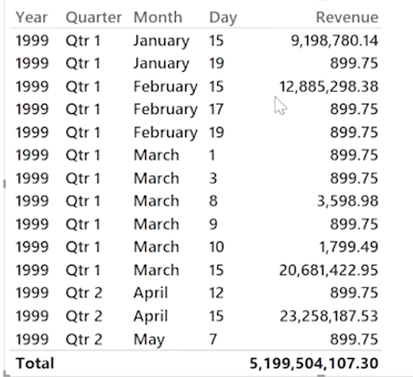
Create calculated tables
When you create a table visualization in your report using a date field, Power BI Desktop automatically includes breakdowns by time period.
For example, the single date field in the Date table can be automatically separated into Year, Quarter, Month and Day by Power BI,

Slide 14
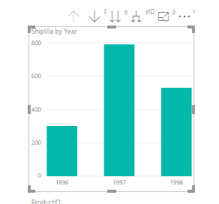
Drill Down
Visualizations display
data at the year level by
default, but you can
change that by turning on
Drill Down in the top
right-hand corner of the
visual.

Slide 15
Drill Down
Visualizations display
data at the year level by
default, but you can
change that by turning on
Drill Down in the top
right-hand corner of the
visual.
You can also drill down through all of the data shown on the visual, rather than one selected period, by using the Drill All double-arrow icon, also in the top right-hand corner of the visual.

